Slide 1





Community Service Project
MENTOR TRAINING - DAY 6

Slide 2
Welcome | 15 | 135 | 9 am - 11:00 am
Warm up - link to topic | 15
Recap | 15
Agenda | 5
Week 3 Introduction to community awareness and IEC campaigns | 90
Break | 15 | 15 | 11:00-11: 15
Introduction to community awareness and IEC campaigns cont | 30
Designing an outreach campaign for case study shared on Day 5 | 60 | 90 | 11:15 am - 1:00 pm
Lunch Break | 60 |  | 1:15pm - 2:15pm
Presentations | 60 | 105 | 2:15 pm - 4:00 pm
Warm up activity | 10
Tools that can help in creating collaterals | 5
Week 3 of student curriculum and week 4-7 explanation | 20
Design thinking | 20

Slide 3
Week 3 of student curriculum explanation , QnA | 30-40
Week 4-8 explanation |  | 105 | 4:00 pm - 5:45 pm
Student sessions and QnA | 30
Gratitude wall | 30
Closing ceremony | 30

Slide 4
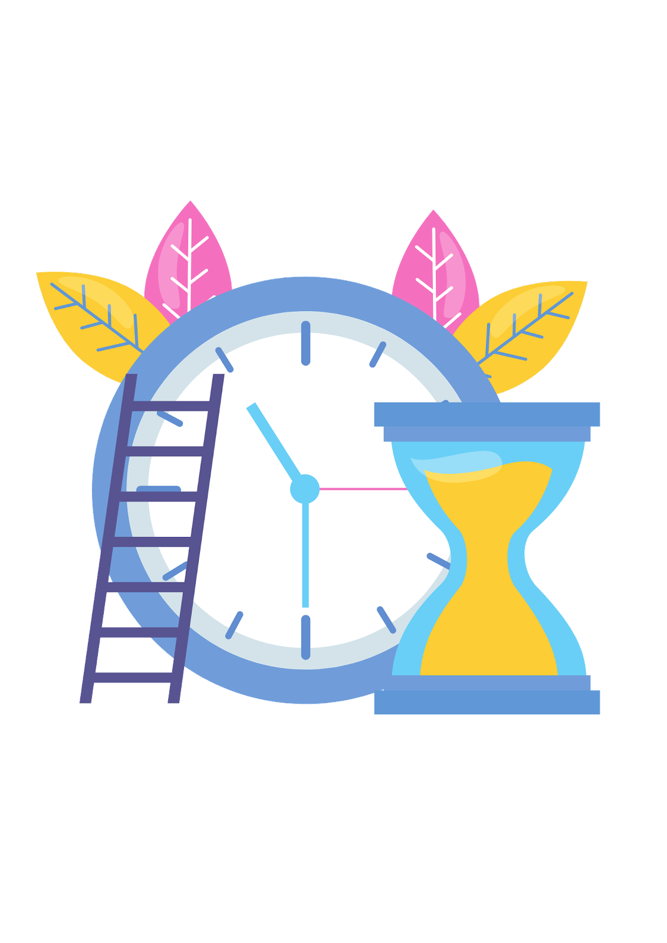
Session 1
135 mins
Welcome
Warm up
Recap
Agenda
Introduction to community awareness and IEC campaigns

Slide 5

Welcome
Welcome to Day 6 of the Mentors Training Session
Reminder to fill in Day 5 feedback form

Slide 6
Energiser - Hands of Power
Let’s get into pairs
Leading learner puts hand in front of the other
Follow the leading learner through the hall
Switch when I ask you to
The follower becomes the leading learner now

Slide 7

How are you feeling now?

Slide 8
Recap
We will be first looking what we did yesterday
Let’s take one post it each and mention one thing that stood out to us the most from the last session
It could even be as simple as a statS from the case studies
Take 3 mins to think and post it on the chart paper
Let’s take 5 mins to go through other responses

Slide 9
Summarize
Look at case studies, read them - Map the key stakeholders and prepare a survey questionnaire based on the research methodology decided
Look at tools needed for data analysis for Survey reporting
How to analyze data and draw conclusions or next action items

Slide 10

Agenda
Introduction to Community Awareness and IEC Campaigns
Tools that can used for the campaigns
Develop a IEC Campaign
Look at Week 3 of Student curriculum
Look at Week 4 - 7 of student curriculum
Things students should know for week 4-7
Day 7 training planning

Slide 11
Step1: Introduction of Community Awareness or IEC Campaigns
What is community awareness campaigns?
Week 1 and 2 - Survey
Week 3 - Students take up community awareness or IEC Campaigns
Community Awareness is generally defined as knowledge created through interaction between community people and its environment. These Awareness campaigns can address groups of people in a region affected by a particular issue like climate threat, groups of stakeholders, the general public, etc.

Slide 12
The aim of Community awareness campaigns
Is to first create/grab attention, give information and then create long-term lasting behavioral changes.
Who can create the campaigns
Community Awareness campaigns can be created by an individual researcher who has identified a community problem and wants to share the information received to create awareness and changes. It can also be conducted by the Govt, non-profits, govt bodies, institutions etc.

Slide 13
IEC - Information, Education and Communication
is a community awareness strategy which is used to spread awareness through communication channels to a target audience to achieve a desired positive result.
Community Mobilization through Information;
Awareness & Action through Education; and
Sustained Behavior Change through Communication
IEC is a comprehensive approach that spans across mass media, digital campaigns, strategic partnerships and ground-level activities.
It is multidisciplinary and target audience-centered in its approach.
IEC uses a mix of these strategies for the approach

Slide 14


Community awareness campaigns
IEC Campaigns
Create a plan/strategy for the community awareness campaign
NOTE
Students can use IEC as their base while creating the community awa

Slide 15

STEP 2: Permissions and responsibilities
Speaking to local authorities about the campaign
Getting permissions, advice for the campaign creation.
Assign responsibilities to friends ( if they are helping)

Slide 16
STEP 3: Strategy and implementation
Ground Analysis
Target Audience (TA) Identification
Define Goals & Objective
Design Messages
Channel/Medium of Communication
Draw up timeline for Implementation
Implementation & Monitoring
NOTE
We will be going through
each of these steps closely

Slide 17

Ground Analysis
Clear understanding of the problem with data as a backing
Local perspectives and use materials reflecting the conditions of the local community

Slide 18

Target Audience (TA) Identification
Who are you designing the campaign for
Stakeholders of the community
Decision makers, professionals, public
individuals who are or could be affected by the problem identified

Slide 19
PRIMARY AUDIENCE
Stakeholders who are directly involved in the campaign
TARGET AUDIENCE
SECONDARY AUDIENCE
Stakeholders who can inform, influence and educate the Primary audience

Slide 20
Define goals and objectives
Goals should also be objectively measurable so that it can be managed and evaluated in an effective way.
Help create a framework for the campaign
For eg: Increase awareness of the benefits of the scheme amongst the beneficiaries by 90%

Slide 21
Design messages
What is the messaging.
Messaging should be different for different stakeholders
Salient, Effective, Goal oriented and Attractive to the community you are working with
How are you going to message it?

Slide 22

Let’s look at an interesting campaign

Slide 23
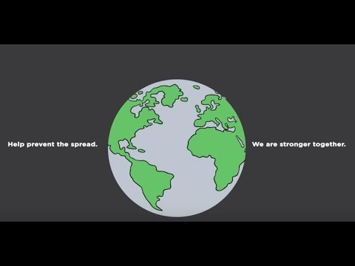
Covid Prevention Campaign
https://www.youtube.com/watch?v=rAj38E7vrS8&t=60s
Was this video clear and did you all get the message?
Who do you think this campaign was designed for?

Slide 24
A good example of - to convey a clear message without relying on written or verbal explanations.

Slide 25
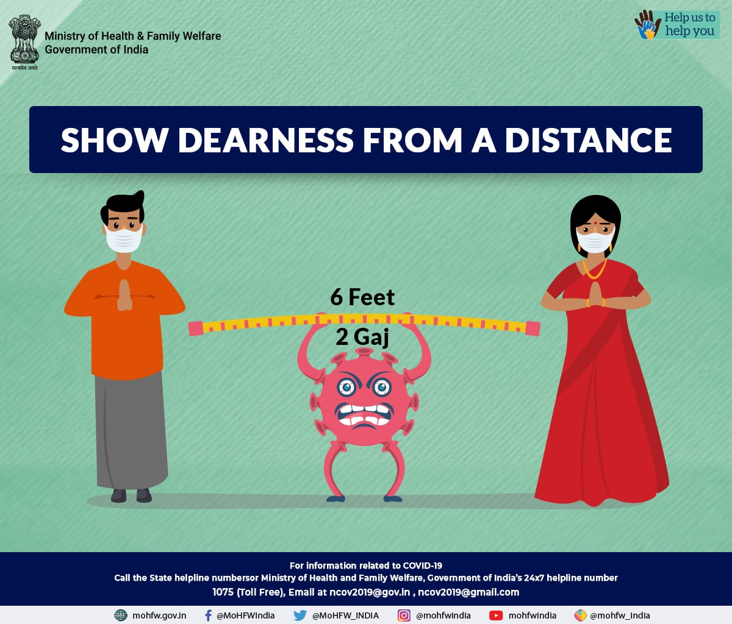
Covid Prevention Campaign
What do you think of the picture?

Slide 26
The graphic focuses on conveying one behavioral message and does so with minimal writing and clear visuals

Slide 27
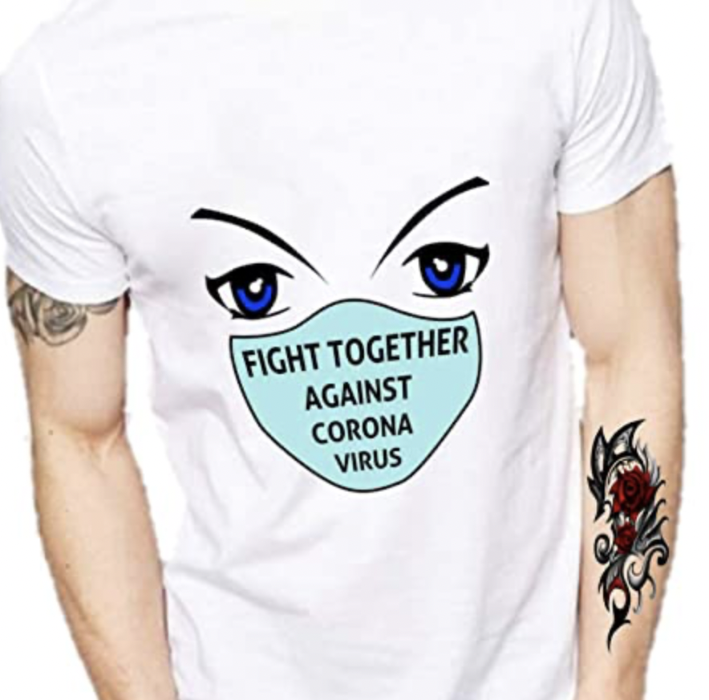
Covid Prevention Campaign
First thing that comes to your mind when you look at this image?

Slide 28
Making the messaging motivating, engaging, catchy and appealing for collective action

Slide 29
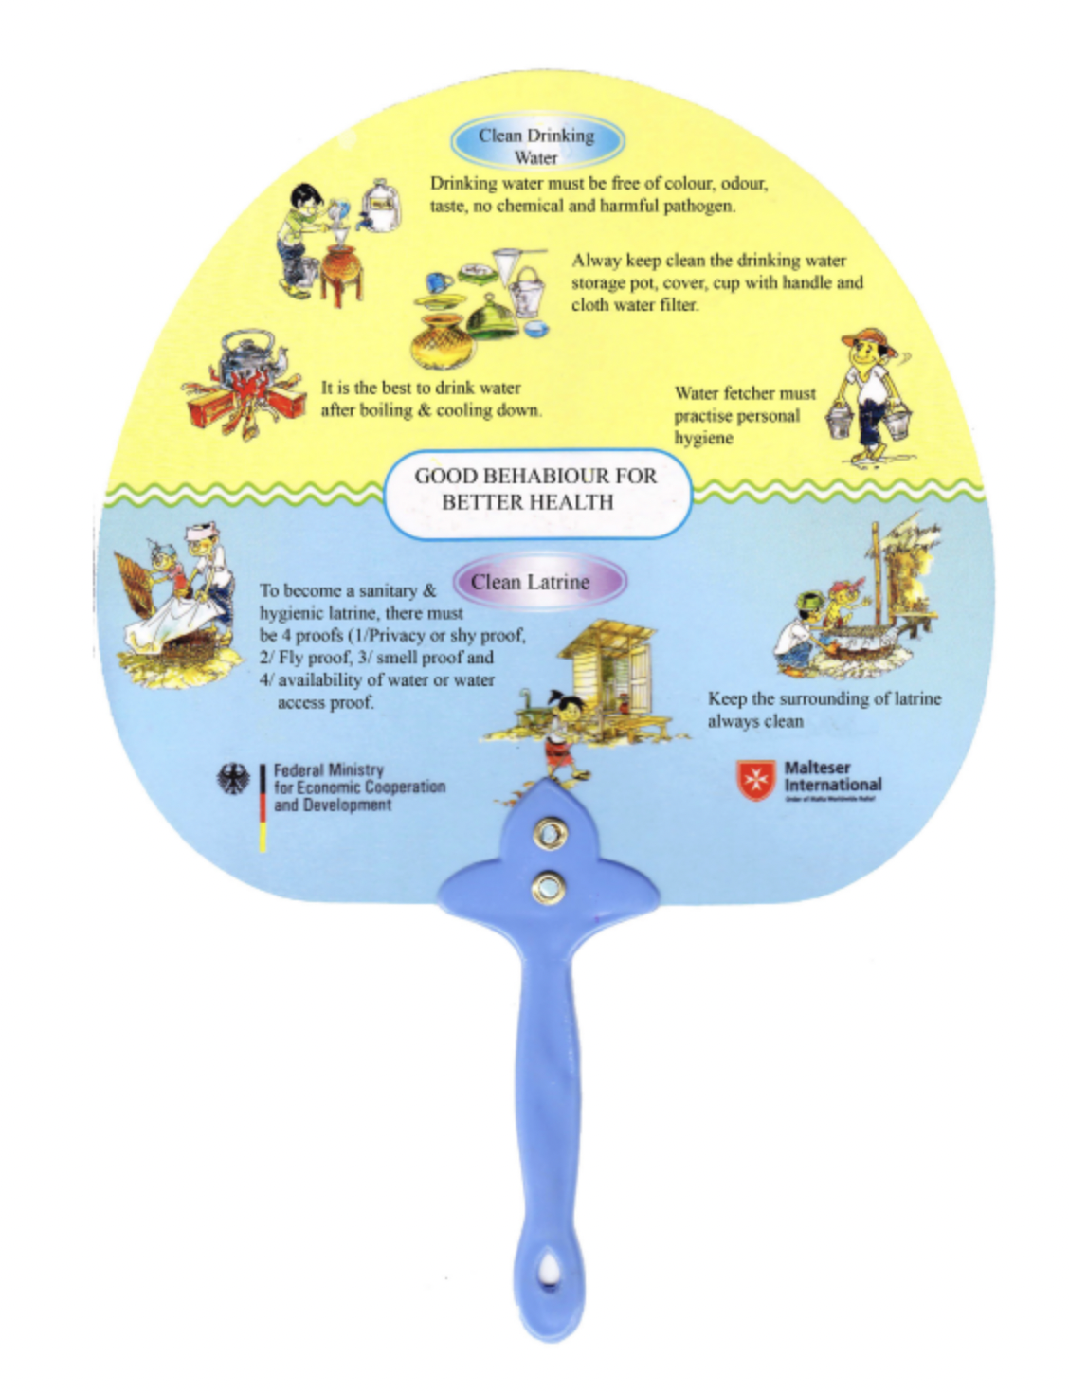
Good health Campaign
What do you think of this campaign, what is unique in this?

Slide 30
Make it usable so people won't throw and can always remind them to do something.

Slide 31
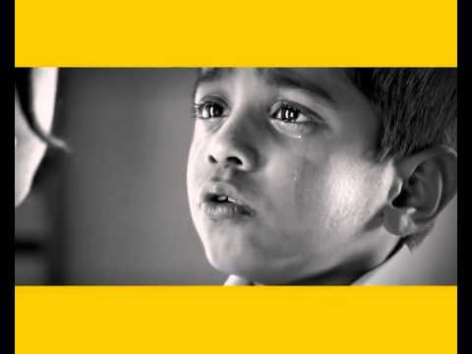
Video on Malnutrition
https://www.youtube.com/watch?v=VAlGdHAMVAA
What do you think is this campaign for?
Why have they used Aamir Khan in this campaign?

Slide 32
Making it trustable. Use relevant sources or celebrities
NOTE
Students can speak to the local government body, Panchayat head to seek their support to create the campaign and make them speak on the day of the campaigning or add in their quotes etc.

Slide 33
Points to keep in mind while designing the messaging for an IEC/Awareness Campaign
Ensure you have conducted prior research
Convey clear message keeping audience in mind
Use visuals which convey the message without words or with minimum usage of words
Messaging has to be engaging, motivating, catchy and drive collective action
Use materials which can be reused and not thrown
Gain trust by using relevant sources information

Slide 34

Channel and Medium of Communication
Case study groups
Activity
Exhaustive List - All the possible ways in which a campaign can be communicated
No right or wrong answer
10 mins

Slide 35
Grouping
Next 10 mins group under
Digital Channels
Physical Channels
Events or on ground campaigns

Slide 36
Digital Channels
Physical Channels
Events or on
ground campaigns
Website, social media platforms such as Twitter, Facebook, YouTube, Instagram, WhatsApp, automated Interactive Voice Response (IVR) services etc
Electronic (TV & Radio),
Print - Newspapers, Magazines, Advertorials
Outdoor - hoardings, banners, kiosks, POS etc at hospitals, local haats, marketplaces, panchayats, government offices, and any other relevant public spaces
Events, workshops, street plays and conferences.

Slide 37
Which medium to go for?
Keep the audience in mind
Cost-effective to reach the audience

Slide 38
Questions that can help
• How many people are you trying to reach with the medium?
• Can the medium deliver the message in the format, time and place most convenient for the target audience?
• Is the medium easily available or accessible and is used by the target audience?
• Do you have the resources required for this medium?

Slide 39
So far…
What is an IEC or community awareness campaign
Permissions to take and give responsibilities
Strategy and implementation
Ground Analysis
Target Audience (TA) Identification
Define Goals & Objective
Design Messages
Channel/Medium of Communication

Slide 40
BREAK
15 MINS

Slide 41
Session 2
135 mins
Timeline
Implementation and monitoring of the community awareness/IEC campaign
Design your own campaign

Slide 42
Draw up Timeline for implementation
Once medium is chosen
Create a timeline
Include - Activities to be done , budget, permissions, requirements etc
Seek permissions
Decide messaging
Inform TA
18th
30th
15th
20th
Create posters
Execute

Slide 43
Target Reach / Outreach
Frequency of communication
Implementation Plan
Final Plan
Evaluate
Impact
Budget
Monitor impact

Slide 44
Implementation and Monitoring
01
Evaluate Impact
Conduct the campaign
Execute the Plan
03
02
Monitor Impact

Slide 45
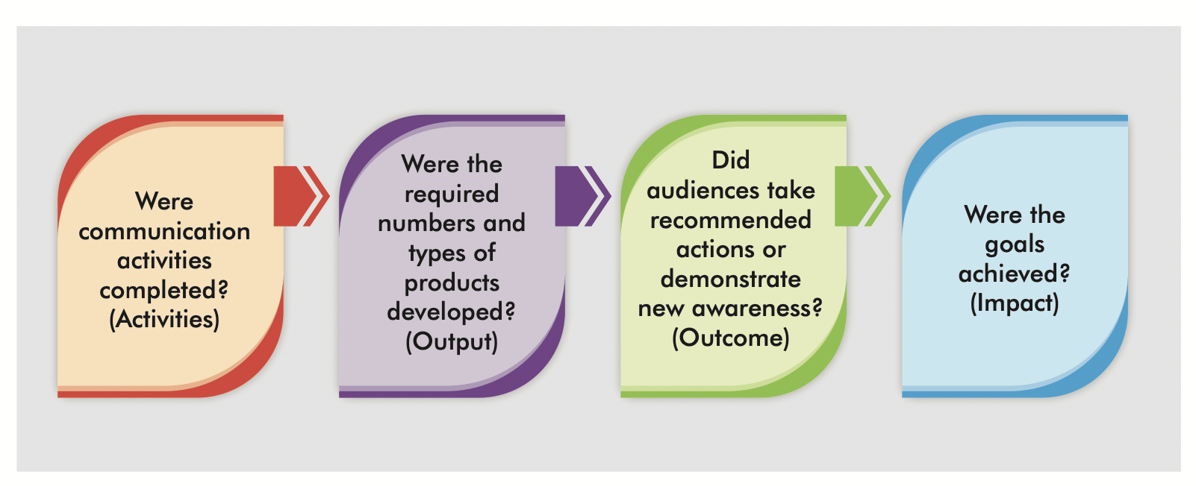
Campaign Report
Campaign report will contain the final plan + communication design materials and the below

Slide 46
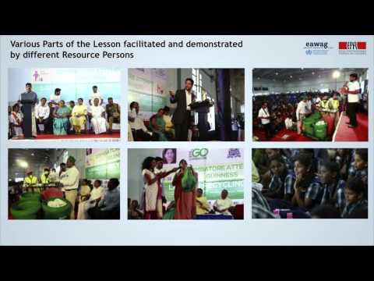
https://www.youtube.com/watch?v=c3hgfVM0HIg

Slide 47
Questions?
5 MINS

Slide 48
Create Your Own Campaign
Case study groups
Create a awareness campaign for your case study
Will not be able to execute the campaign to the target audience
Steps that one needs to take till implementation of the campaign
15 mins to fill these questions
Ground Analysis
Target Audience (TA) Identification
Define Goals & Objective

Slide 49
Ground Analysis
Target Audience (TA) Identification
Clear understanding of the problem with data as a backing
Local perspectives and use materials reflecting the conditions of the local community
Who are you designing the campaign for - Primary/Secondary
Decision makers, professionals, public
individuals who are or could be affected by the problem identified

Slide 50
Define goals and objectives
Goals should also be objectively measurable so that it can be managed and evaluated in an effective way.
Help create a framework for the campaign
For eg: Increase awareness of the benefits of the scheme amongst the beneficiaries by 90%

Slide 51
CREATE THE CAMPAIGN
Campaign for our sample case
Think of messaging and medium with the constraints
10 mins - all ideas on how to campaign
Note down all ideas/don’t judge
Constraints - what can you do?
Final campaign
1
2
3
4
5
6

Slide 52
Design messages
What is the messaging.
Messaging should be different for different stakeholders
Salient, Effective, Goal oriented and Attractive to the community you are working with
How are you going to message it?

Slide 53
Points to keep in mind while designing the messaging for an IEC/Awareness Campaign
Ensure you have conducted prior research
Convey clear message keeping audience in mind
Use visuals which convey the message without words or with minimum usage of words
Messaging has to be engaging, motivating, catchy and drive collective action
Use materials which can be reused and not thrown
Gain trust by using relevant sources information

Slide 54
Digital Channels
Physical Channels
Events or on
ground campaigns
Website, social media platforms such as Twitter, Facebook, YouTube, Instagram, WhatsApp, automated Interactive Voice Response (IVR) services etc
Electronic (TV & Radio),
Print - Newspapers, Magazines, Advertorials
Outdoor - hoardings, banners, kiosks, POS etc at hospitals, local haats, marketplaces, panchayats, government offices, and any other relevant public spaces
Events, workshops, street plays and conferences.

Slide 55

Great Minds at Work - 30 mins

Slide 56


Slide 57
BREAK
60 MINS

Slide 58
Session 3
105 mins
Group sharing of Campaign creation
Activity on shortlisting
Tools required
Week 3-7 and Design Thinking

Slide 59

Welcome Back
Let’s begin sharing our amazing work
Each team has to mention
2 teams to give them 2 things you really liked about their presentation
Ground Analysis
Target Audience (TA) Identification
Define Goals & Objective
Design Messages
Choosing Channel/Medium of Communication
And present their campaign

Slide 60


Slide 61
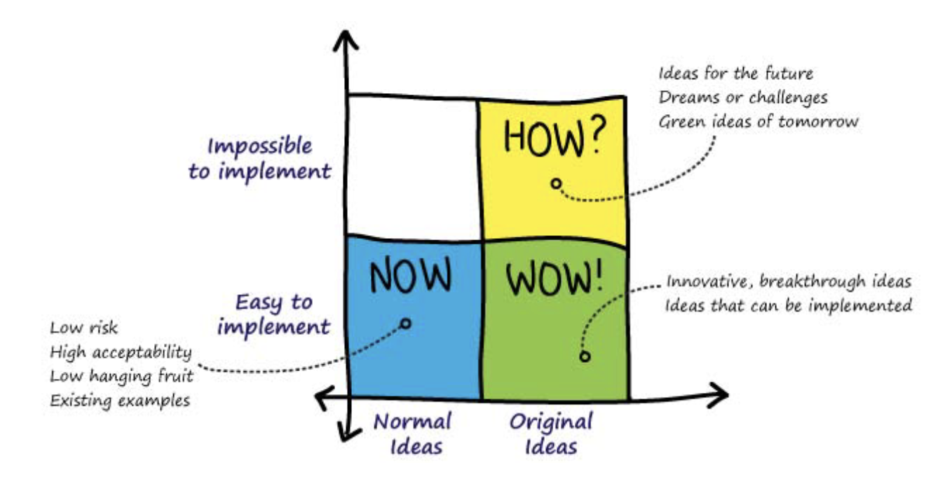
Activity Time - HOW, NOW, WOW

Slide 62
Draw
Case groups
Draw a 2-by-2 matrix as above. The X axis denotes the originality of the idea and the Y axis shows the ease of implementation.

Slide 63
Label each quadrant as
1. Now/Blue Ideas – Normal ideas, easy to implement. These are typically low hanging fruit and solutions to fill existing gaps in demands.
2. How/Yellow Ideas – Original ideas, impossible to implement. These are breakthrough ideas in terms of impact, but absolutely impossible to implement
3. Wow/Green Ideas – Original ideas, easy to implement. ‘Wow’ ideas are those with potential for orbit-shifting change and possible to implement within current reality.

Slide 64
Voting
- List down the ideas that emerged from the ideation activities done earlier
- Each learner gets 2 sticky dots/sketch pens of each colour – 2 blue, 2 yellow, 2 green.
- Each learner votes for 2 best ideas in each category.
They need to do this by sticking a coloured dot in front of each idea they choose.
- In the end, count the number of dots under each idea to categorize it. The highest number of dots of a certain colour categorizes the idea under that colour.
Idea 1
Idea 2
Idea 3
Idea 4
Idea 5
Idea 6
Idea 7
Idea 8
Idea 9

Slide 65
Activity - 10 mins
You have 10 mins to complete this activity
Idea 1
Idea 2
Idea 3
Idea 4
Idea 5
Idea 6
Idea 7
Idea 8
Idea 9

Slide 66

Yayyy
How did you feel doing this activity?
Were you able to shortlist feasible campaign ideas ?
Students will be doing a similar exercise with their friends to shortlist the campaign
NOTE

Slide 67

Online Tools for creating campaign posters/social media creatives
Canva
GIMP
Inkscape
Adobe Illustrator
Photoshop
Filmora
Bytable
Each tool video will be shared with the students
NOTE

Slide 68
Week 3 - 7
Look at Week 3-7 content for students
Main Project
Once students finish their campaign
They will then move into their main project
Fist they will go through design thinking to identify their project - the student/s could take up project work related to their domain, survey or subject area.

Slide 69

Areas could be
Agriculture
Health
Marketing and Cooperation
Animal Husbandry
Horticulture
Fisheries
Sericulture
Revenue and Survey
Natural Disaster Management
Irrigation
Law & Order
Excise and Prohibition
Mines and Geology
Energy

Slide 70

Project includes
Data collection, interviews, awareness if any, social entrepreneurship, experiments internship in any select unit or department.

Slide 71
Then they will be reporting their project in week 8
20 mins to go through
Spend another 10 mins on Week 1 and 2
Pause for questions
NOTE

Slide 72
Week 4-7
By week 3 students have completed a socio economic survey and an IEC campaign
Main project they will go through Design thinking process to identify the project they want to work on
Students will be given a list of areas in which they can do their project or could be an issue they have identified during the survey
Let’s do a quick sample of the activity they will be doing
Individually take a chart paper and some sketch pens

Slide 73
Areas could be
Agriculture
Health
Marketing and Cooperation
Animal Husbandry
Horticulture
Fisheries
Sericulture
Revenue and Survey
Natural Disaster Management
Irrigation
Law & Order
Excise and Prohibition
Mines and Geology
Energy

Slide 74
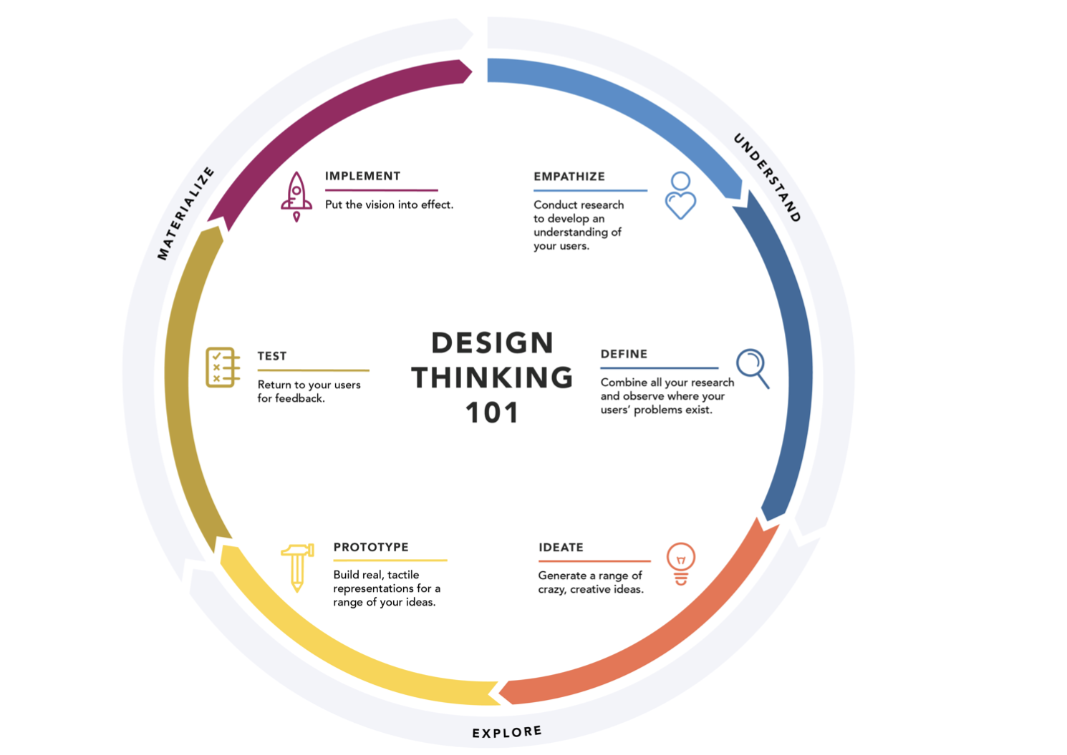

Slide 75

STEP 1: Empathy
The first step of design thinking process is empathy - to conduct research to develop an understanding of your users
If students choose to work on a project where the problem was identified in the survey he/she can skip the first step and do a smaller survey around the problem identified.
If the student chooses a new area they he/she has to first do the survey and then move to the second step

Slide 76

STEP 2: Define
Defining the problem
Combining all their research and laying it out
Problem tree Analysis
5 whys
Problem statement

Slide 77
STEP 3: Ideate
What could the probable solutions be?

Slide 78

Activity
Think of an example:
Problem statement:
Cleaning drinking water
“Water received in the taps in village X is contaminated
which is leading to many health related problems since 2019”

Slide 79

Think of all possible solutions
Think of all the ideas/ solutions you can
Remember - don't judge the solutions just write them down
10 mins

Slide 80
How many did you come up with?

Slide 81
01
Product
02
Service
03
Findings/ Propose solutions/Next Steps
04
Experiments
05
Research In-depth/Internship

Slide 82
Think of all possible solutions in the framework
10 mins

Slide 83
How many did you come up with?

Slide 84
Shortlist
Finalise one solution you will be working with which will become you project - 5 mins
The solution could be
A Product
A Service
In depth findings and propose solutions to relevant bodies
Set of Experiment
Further Research

Slide 85
Framework
Keep this framework in mind while finalising the solution
Can I finish this project in 4 weeks
Do I have the resources to work on the solution ( Monetary, Mentor, Local Body support etc.)
How excited am I about this solution?
Time’s up, have you thought of the final solution?
Note down the solution - Project
My Final Idea/Solution which I will be working on for my project is__________________________________________________

Slide 86

STEP 3: Prototype
Students will think of how the solution will look like in reality
What do you think they have to do next?
Prototype is the very first version of their solution put down on a paper
It is a preliminary step before doing a sample or project plan for your project
A prototype can be done for any of the type of solution they choose

Slide 87
Eg if it is a social product then they can do a physical model, diagram, sketch of it
Eg if it a service then they can put down a storyboard on how they will do the service, who all will they speak to, service etc
Eg if their solution is to do experiments
Sample: take the water and see how to treat it, then they will make diagrams of the steps they will take, who all will they work with
Eg if they are doing an internship with the waterboard
Their prototype will be to note down the steps they will take to get to the internship and what till they do next

Slide 88
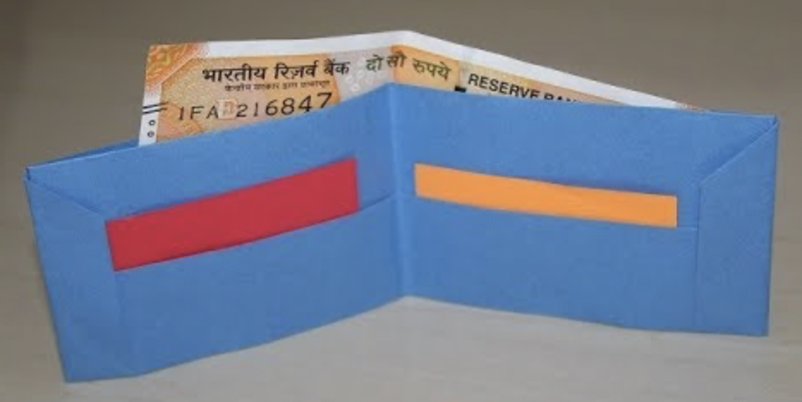
Model

Slide 89
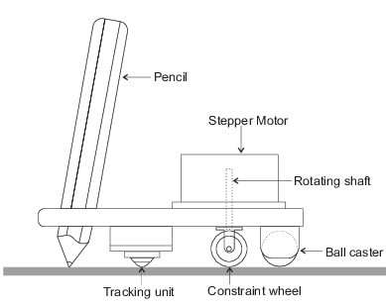
Diagram

Slide 90
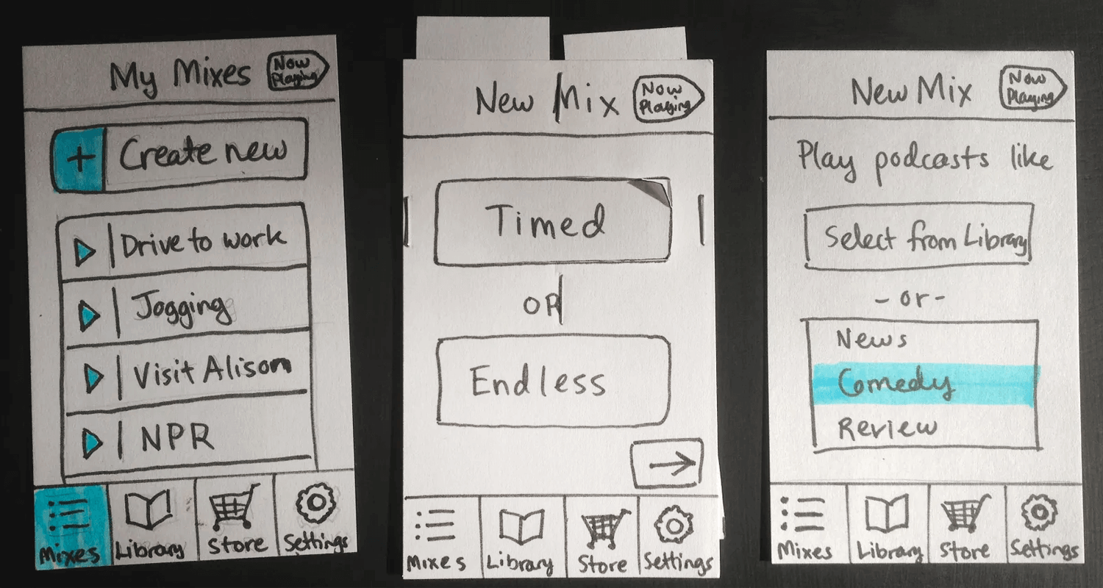
Sketch

Slide 91
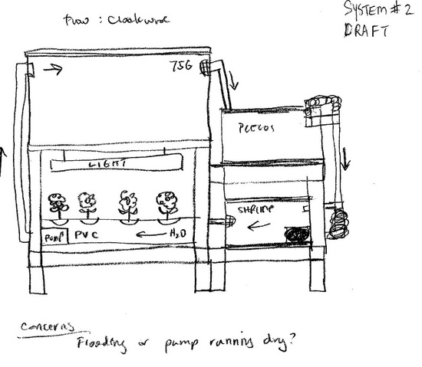
Sketch

Slide 92
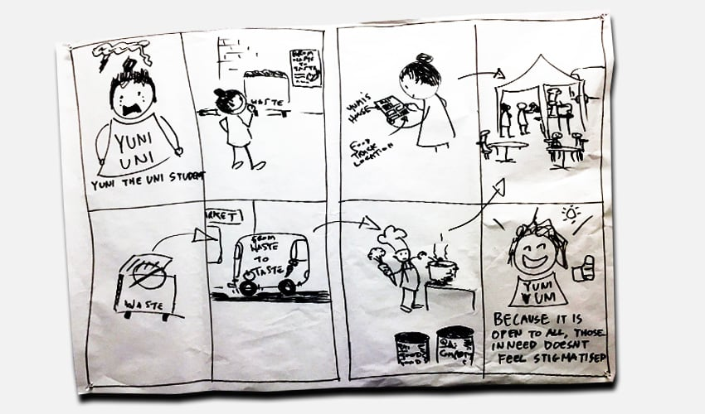
Storyboard

Slide 93
Let’s try making a prototype for the solution we finalized

Slide 94
You have 5 mins to work on your prototype

Slide 95
BREAK
15 MINS

Slide 96
Session 4
105 mins
Week 8
Planning of Day 7 training
QnA
Closing

Slide 97
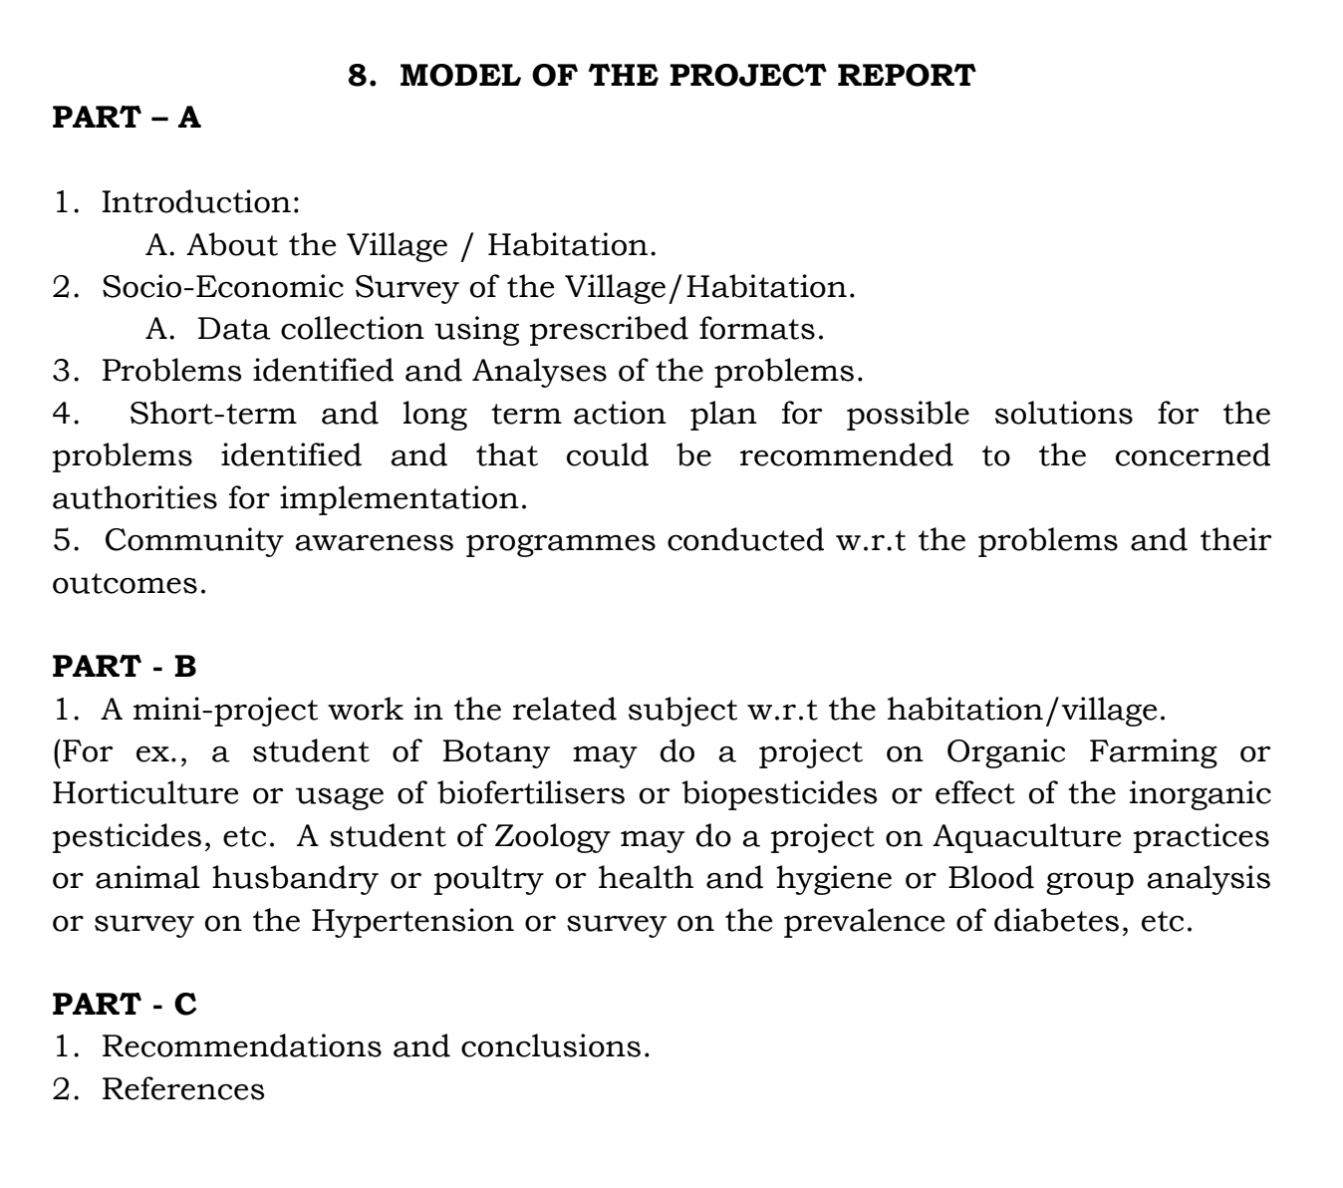
Week 8
Collate all the work of Week 1- 7
Work on Project report
Present

Slide 98
QnA
10 MINS

Slide 99
Resources
Student Curriculum
Program Curriculum
All examples and case studies
Handbook with links to all

Slide 100
Next steps

Slide 102
Gratitude Wall
2 Post-it's
1- one thing that you are proud of yourself
1 more to another person in this group who helped you in this journey ( with name)

Slide 103
Recall
Introduction to Community Awareness and IEC Campaigns
Tools that can used for the campaigns
Develop a IEC Campaign
Look at Week 3 of Student curriculum
Look at Week 4 - 7 of student curriculum
Things students should know for week 4-8

Slide 104
Closing
How confident are you to take this project to the students ?
Give a rating on 5, 1 being not confident at all and 5 being very confident
Link:

